Slide 1

Variables, Data Types, and Operators in C# for Unity

Slide 2
Learning Objectives
Understand the role of variables in C#.
Learn about different data types and their usage.
Gain proficiency in using operators for various operations.

Slide 3
Setting Up Development Environment
Introduction to Scripting
C# Basics: Syntax and Structure
Introduction to C#
Basics of Unity Scripting in C#

Slide 4
Setting Up Development Environment
Unity supports the following IDEs:
Visual Studio: When you install Unity on Windows and macOS, by default Unity also installs Visual Studio or Visual Studio for Mac, respectively. By default, the External Script Editor (menu: Unity > Preferences > External Tools > External Script Editor) is set to Visual Studio
Visual Studio Code: Unity supports opening scripts in Visual Studio Code (VS Code). To open scripts in VS Code, go to Unity > Preferences > External Tools > External Script Editor and select Visual Studio Code
JetBrains Rider: Unity supports opening scripts in JetBrains Rider. To open scripts in Rider, go to Unity > Preferences > External Tools > External Script Editor and select Rider.
Image source: Unity.com
Notes:
Integrated development environment (IDE) support
An integrated development environment (IDE) is a piece of computer software that provides tools and facilities to make it easier to develop other pieces of software. Unity supports the following IDEs:
Visual Studio
Visual Studio Code
JetBrains Rider
Visual Studio (default IDE on Windows and macOS)
When you install Unity on Windows and macOS, by default Unity also installs Visual Studio or Visual Studio for Mac, respectively. You can choose to exclude it when you select which components to download and install. By default, the External Script Editor (menu: Unity > Preferences > External Tools > External Script Editor) is set to Visual Studio. When you enable this option, Unity launches Visual Studio and uses it as the default editor for all script files. For more information, see Visual Studio C# Integration.
On macOS, Unity installs Visual Studio for Mac as the C# IDE. Visual Studio Tools for Unity (VSTU) provides Unity integration for Visual Studio for Mac (VS4M). For information on setting up and using Visual Studio for Mac, see the following Microsoft documentation pages:
Visual Studio Tools for Unity
Setup Visual Studio for Mac Tools for Unity
Using Visual Studio for Mac Tools for Unity
Note: On Windows, Unity also includes Visual Studio 2019 Community by default in the installation package.
Visual Studio Code (Windows, macOS, Linux)
Unity supports opening scripts in Visual Studio Code (VS Code). To open scripts in VS Code, go to Unity > Preferences > External Tools > External Script Editor and select Visual Studio Code. For information on using VS Code with Unity, see Visual Studio’s documentation on Unity Development with VS Code.
Prerequisites
To use Visual Studio Code for C# code editing and Unity C# debugging support, you need to install:
Mono (only required on macOS and Linux)
Visual Studio Code C# Extension
Visual Studio Code Debugger for Unity Extension (Not officially supported by Unity)
JetBrains Rider (Windows, macOS, Linux)
Unity supports opening scripts in JetBrains Rider. To open scripts in Rider, go to Unity > Preferences > External Tools > External Script Editor and select Rider.
Rider is based on ReSharper and includes most of its features. It supports all of C# 7.2’s features as well as C# debugging on the .NET 4.6 scripting runtime in Unity. For more information, see JetBrains’ documentation on Rider for Unity.

Slide 5
Setting Up Development Environment
Debug C# code in Unity
You can use a debugger to inspect your source code while your application is running. Unity supports the following code editors to debug C# code:
Visual Studio (with the Visual Studio Tools for Unity plug-in)
Visual Studio for Mac
Jetbrains Rider
Visual Studio Code (experimental)
Image source: Unity.com
Notes:
Debug C# code in Unity
You can use a debugger to inspect your source code while your application is running. Unity supports the following code editors to debug C# code:
Visual Studio (with the Visual Studio Tools for Unity plug-in)
Visual Studio for Mac
Jetbrains Rider
Visual Studio Code (experimental)
Although these code editors vary slightly in the debugging features they support, they all provide basic functionality such as break points, single stepping, and variable inspection. You can attach these code editors to the Unity Editor or Unity Player to debug your code.
Managed code debugging in Unity works on all platforms except WebGL. It works with both the Mono and IL2CPP scripting backends

Slide 6
Setting Up Development Environment
Visual Studio C# integration
Unity integrates with Microsoft Visual Studio through the Code Editor Package for Visual Studio. This package is pre-installed when you install Unity. If Visual Studio is installed at the time you install Unity, then Unity uses Visual Studio to open and edit scripts by default.
Image source: Unity.com

Slide 7
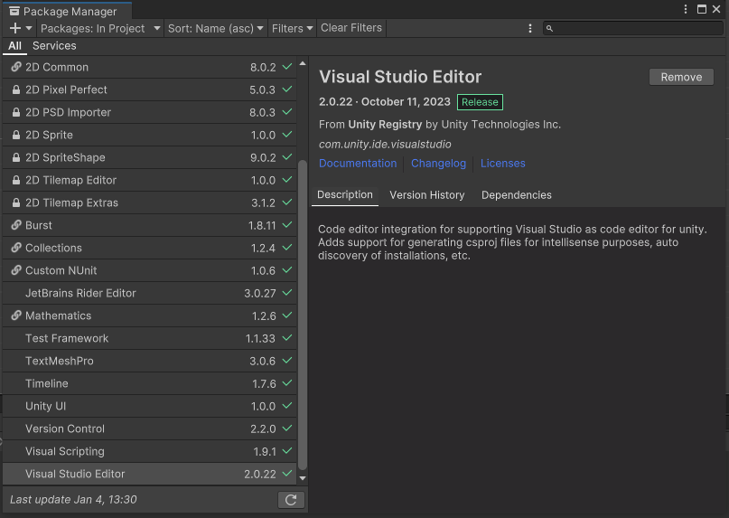
Setting Up Development Environment
Visual Studio C# integration
The Visual Studio Editor in the Package Manager Window
Image source: Unity.com

Slide 8
Setting Up Development Environment
Set Visual Studio as your default script editor
Unity automatically uses Visual Studio as its default script editor if Visual Studio is installed when you install Unity, or if you install Visual Studio as part of the Unity installation process.
To set your default script editor manually:
Go to Edit > Preferences (macOS: Unity > Settings) in the main menu to open the Preferences window.
Open the External Tools menu.
Click on the External Script Editor dropdown and select Microsoft Visual Studio. The appearance of this option changes depending on the version of Microsoft Visual Studio you have installed.
Image source: Unity.com

Slide 9
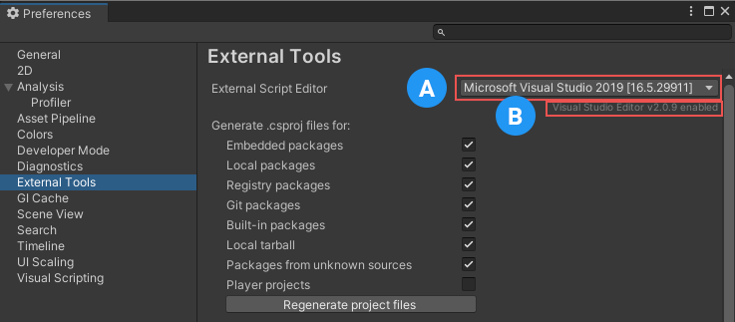
Setting Up Development Environment
Set Visual Studio as your default script editor
External Tool Settings
A: The External Script Editor dropdown menu, which displays the name and version of the selected script editor.
B: The name and version of the Unity package that integrates with the selected script editor.
Image source: Unity.com
Notes:
Unity automatically uses Visual Studio as its default script editor if Visual Studio is installed when you install Unity, or if you install Visual Studio as part of the Unity installation process. You can install Visual Studio as a module into an existing Unity installation. For more information, see Downloading and installing Editors and modules with the Unity Hub.
To set your default script editor manually:
Go to Edit > Preferences (macOS: Unity > Settings) in the main menu to open the Preferences window.
Open the External Tools menu.
Click on the External Script Editor dropdown and select Microsoft Visual Studio. The appearance of this option changes depending on the version of Microsoft Visual Studio you have installed.
External Tool SettingsA: The External Script Editor dropdown menu, which displays the name and version of the selected script editor.
B: The name and version of the Unity package that integrates with the selected script editor.
Unity uses Visual Studio’s C# compiler to compile scripts. When you use the Visual Studio Editor package with Visual Studio, both Unity and Visual Studio display details of any errors in your scripts.
Unity automatically creates and maintains a Visual Studio .sln and .csproj file. You can control whether Unity generates .csproj files for certain elements of your project in the External Tools menu in the Preferences window, as in the above screenshot. Enable or disable the checkboxes to toggle whether Unity generates .csproj files for a given option.
Unity regenerates the .sln and .csproj files in your project whenever a contributor makes changes to the state of a file, for example, editing an existing file or creating a new one. You can also add files to your solution from Visual Studio. Unity imports any new files, and the next time Unity creates the project files again, it creates them with the new files included.

Slide 10
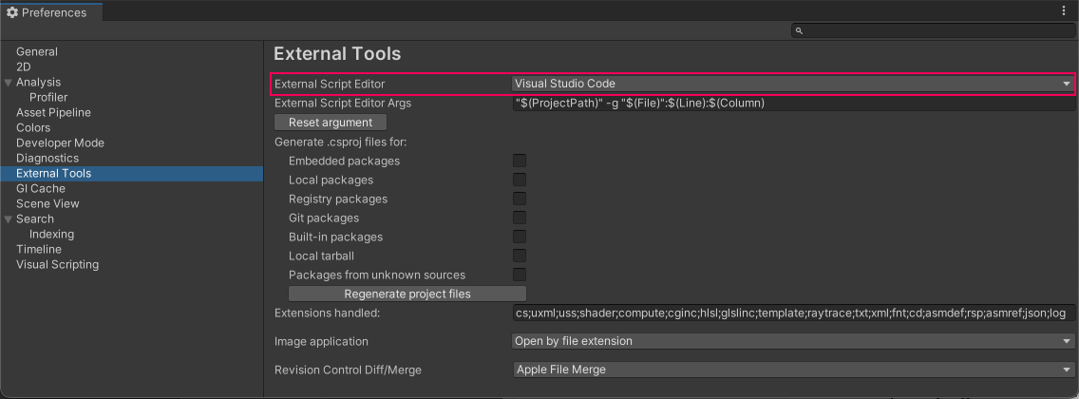
Setting Up Development Environment
Debug C# code in Unity
After a code editor is installed, open Unity, go to Preferences > External Tools and set the External Script Editor to your code editor.
Image source: Unity.com

Slide 11
Setting Up Development Environment
Debug C# code in Unity
More detail, refer: https://docs.unity3d.com/Manual/ManagedCodeDebugging.html.
Image source: Unity.com

Slide 12
Setting Up Development Environment
Configure the code editor
Visual Studio (Windows):
The Unity Editor installer includes an option to install Visual Studio with the Visual Studio Tools for Unity plug-in.
If Visual Studio is already installed on your computer, open it and go to Tools > Get Tools and Features… to locate and install the Visual Studio Tools for Unity plug-in.
Visual Studio for Mac
The Unity Editor installer includes an option to install Visual Studio for Mac. If Visual Studio for Mac is already installed on your computer, open it and go to Visual Studio > Extensions > Install from file… to locate and install the Visual Studio Tools for Unity plug-in.
JetBrains Rider
You can use the default installation of JetBrains Rider to debug code in Unity on Windows or Mac
Image source: Unity.com
Notes:
Configure the code editor
Visual Studio (Windows)
The Unity Editor installer includes an option to install Visual Studio with the Visual Studio Tools for Unity plug-in . This is the recommended way to set up Visual Studio for debugging with Unity.
If Visual Studio is already installed on your computer, open it and go to Tools > Get Tools and Features… to locate and install the Visual Studio Tools for Unity plug-in.
Visual Studio for Mac
The Unity Editor installer includes an option to install Visual Studio for Mac. This is the recommended way to set up Visual Studio for Mac for debugging with Unity.
If Visual Studio for Mac is already installed on your computer, open it and go to Visual Studio > Extensions > Install from file… to locate and install the Visual Studio Tools for Unity plug-in.
JetBrains Rider
You can use the default installation of JetBrains Rider to debug code in Unity on Windows or Mac. Visit the JetBrains website to install it.
Visual Studio Code
To debug in Unity using Visual Studio Code, you need to install an extension. See Visual Studio Code’s documentation to configure Visual Studio Code as the code editor for your Unity project. Follow Visual Studio Code’s instructions specific to the Debugger for Unity extension to install it. Unity’s support for Visual Studio Code is experimental as Unity does not officially support the Debugger for Unity extension.

Slide 13
Setting Up Development Environment
Stack trace logging
Unity Console messages and log files can include detailed stack trace information. The console also links to the line of code that generated the message. This is useful when you want to identify the line, method, or sequence of function calls that caused the log entry to appear.
More detail, refer: https://docs.unity3d.com/Manual/StackTrace.html
Image source: Unity.com

Slide 14
Introduction to Scripting
Scripting is crucial in games, from basic ones to complex ones. It's needed for player input responses, event sequencing, graphical effects, object behavior, and custom AI systems
Scripting is a skill that takes some time and effort to learn.
GameObjects' behavior is dictated by attached Components in Unity. While Unity's built-in Components are versatile, creating custom Components using scripts becomes necessary for implementing unique gameplay features. These custom Components enable triggering events, modifying properties, and responding to user input as needed.
Image source: Unity.com
Notes:
Scripting is an essential ingredient in all games. Even the simplest game needs scripts, to respond to input from the player and arrange for events in the gameplay to happen when they should. Beyond that, scripts can be used to create graphical effects, control the physical behaviour of objects or even implement a custom AI system for characters in the game.
Scripting is a skill that takes some time and effort to learn.
The behavior of GameObjects is controlled by the Components that are attached to them. Although Unity’s built-in Components can be very versatile, you will soon find you need to go beyond what they can provide to implement your own gameplay features. Unity allows you to create your own Components using scripts. These allow you to trigger game events, modify Component properties over time and respond to user input in any way you like.

Slide 15
Introduction to Scripting
Unity supports the C# programming language natively. C# (pronounced C-sharp) is an industry-standard language similar to Java or C++.
In addition to this, many other .NET languages can be used with Unity if they can compile a compatible DLL
Image source: Unity.com
Notes:
Scripting is an essential ingredient in all games. Even the simplest game needs scripts, to respond to input from the player and arrange for events in the gameplay to happen when they should. Beyond that, scripts can be used to create graphical effects, control the physical behaviour of objects or even implement a custom AI system for characters in the game.
Scripting is a skill that takes some time and effort to learn.
The behavior of GameObjects is controlled by the Components that are attached to them. Although Unity’s built-in Components can be very versatile, you will soon find you need to go beyond what they can provide to implement your own gameplay features. Unity allows you to create your own Components using scripts. These allow you to trigger game events, modify Component properties over time and respond to user input in any way you like.

Slide 16
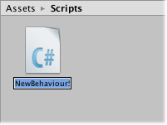
Introduction to Scripting
Creating Scripts
A new script can be created from the Create menu at the top left of the Project panel or by selecting Assets > Create > C# Script from the main menu.
The new script will be created in whichever folder selected in the Project panel. The new script file’s name will be selected, prompting user to enter a new name.
Image source: Unity.com
Notes:
Unlike most other assets, scripts are usually created within Unity directly. You can create a new script from the Create menu at the top left of the Project panel or by selecting Assets > Create > C# Script from the main menu.
The new script will be created in whichever folder you have selected in the Project panel. The new script file’s name will be selected, prompting you to enter a new name.
It is a good idea to enter the name of the new script at this point rather than editing it later. The name that you enter will be used to create the initial text inside the file, as described below.

Slide 17
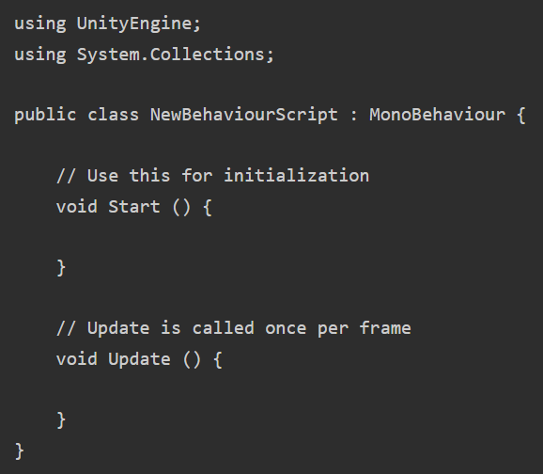
Introduction to Scripting
Anatomy of a Script file
When double-click a script Asset in Unity, it will be opened in a text editor. By default, Unity will use Visual Studio, but user can select any editor you like from the External Tools panel in Unity’s preferences (go to Unity > Preferences).
The initial contents of the file will look something like this:
Image source: Unity.com
Notes:
Anatomy of a Script file
When you double-click a script Asset in Unity, it will be opened in a text editor. By default, Unity will use Visual Studio, but you can select any editor you like from the External Tools panel in Unity’s preferences (go to Unity > Preferences).
The initial contents of the file will look something like this:
A script makes its connection with the internal workings of Unity by implementing a class which derives from the built-in class called MonoBehaviour. You can think of a class as a kind of blueprint for creating a new Component type that can be attached to GameObjects. Each time you attach a script component to a GameObject, it creates a new instance of the object defined by the blueprint. The name of the class is taken from the name you supplied when the file was created. The class name and file name must be the same to enable the script component to be attached to a GameObject.
The main things to note, however, are the two functions defined inside the class. The Update function is the place to put code that will handle the frame update for the GameObject. This might include movement, triggering actions and responding to user input, basically anything that needs to be handled over time during gameplay. To enable the Update function to do its work, it is often useful to be able to set up variables, read preferences and make connections with other GameObjects before any game action takes place. The Start function will be called by Unity before gameplay begins (ie, before the Update function is called for the first time) and is an ideal place to do any initialization.
Note to experienced programmers: you may be surprised that initialization of an object is not done using a constructor function. This is because the construction of objects is handled by the editor and does not take place at the start of gameplay as you might expect. If you attempt to define a constructor for a script component, it will interfere with the normal operation of Unity and can cause major problems with the project.

Slide 18
Introduction to Scripting
Anatomy of a Script file
In Unity, a script connects with the engine by implementing a class derived from MonoBehaviour, serving as a blueprint for a new Component attached to GameObjects.
The class name, derived from the file name, must match for attachment.
Two key functions:
Update: handling frame updates for GameObject actions. This might include movement, triggering actions and responding to user input, basically anything that needs to be handled over time during gameplay
Start: called before gameplay, ideal for initialization tasks.
Image source: Unity.com
Notes:
Anatomy of a Script file
When you double-click a script Asset in Unity, it will be opened in a text editor. By default, Unity will use Visual Studio, but you can select any editor you like from the External Tools panel in Unity’s preferences (go to Unity > Preferences).
The initial contents of the file will look something like this:
A script makes its connection with the internal workings of Unity by implementing a class which derives from the built-in class called MonoBehaviour. You can think of a class as a kind of blueprint for creating a new Component type that can be attached to GameObjects. Each time you attach a script component to a GameObject, it creates a new instance of the object defined by the blueprint. The name of the class is taken from the name you supplied when the file was created. The class name and file name must be the same to enable the script component to be attached to a GameObject.
The main things to note, however, are the two functions defined inside the class. The Update function is the place to put code that will handle the frame update for the GameObject. This might include movement, triggering actions and responding to user input, basically anything that needs to be handled over time during gameplay. To enable the Update function to do its work, it is often useful to be able to set up variables, read preferences and make connections with other GameObjects before any game action takes place. The Start function will be called by Unity before gameplay begins (ie, before the Update function is called for the first time) and is an ideal place to do any initialization.
Note to experienced programmers: you may be surprised that initialization of an object is not done using a constructor function. This is because the construction of objects is handled by the editor and does not take place at the start of gameplay as you might expect. If you attempt to define a constructor for a script component, it will interfere with the normal operation of Unity and can cause major problems with the project.

Slide 19

Introduction to Scripting
Controlling a GameObject
In Unity, a script serves as a blueprint for a Component, with its code activating only when attached to a GameObject. Attachment can be done by dragging the script asset to a GameObject in the hierarchy panel or the selected GameObject's inspector. The Component menu's Scripts submenu displays all available scripts, including user-created ones. The script instance looks much like any other Component in the Inspector:
Image source: Unity.com
Notes:
As noted above, a script only defines a blueprint for a Component and so none of its code will be activated until an instance of the script is attached to a GameObject. You can attach a script by dragging the script asset to a GameObject in the hierarchy panel or to the inspector of the GameObject that is currently selected. There is also a Scripts submenu on the Component menu which will contain all the scripts available in the project, including those you have created yourself. The script instance looks much like any other Component in the Inspector:

Slide 20
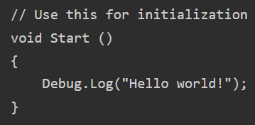
Introduction to Scripting
Controlling a GameObject
Once attached, the script will start working when user press Play and run the game. It can be checked by adding the following code in the Start function:
Debug.Log is a simple command that just prints a message to Unity’s console output. If Play is pressed, the message should appear at the bottom of the main Unity editor window and in the Console window (menu: Window > General > Console)
Image source: Unity.com
Notes:
As noted above, a script only defines a blueprint for a Component and so none of its code will be activated until an instance of the script is attached to a GameObject. You can attach a script by dragging the script asset to a GameObject in the hierarchy panel or to the inspector of the GameObject that is currently selected. There is also a Scripts submenu on the Component menu which will contain all the scripts available in the project, including those you have created yourself. The script instance looks much like any other Component in the Inspector:
Debug.Log is a simple command that just prints a message to Unity’s console output. If you press Play now, you should see the message at the bottom of the main Unity editor window and in the Console window (menu: Window > General > Console)

Slide 21
Introduction to C#
C# (pronounced C sharp) is a versatile, modern, and object-oriented programming language developed by Microsoft.
Key Characteristics:
Type-safe: Ensures data integrity and reduces errors.
Efficient: Provides high performance and memory management.
Object-oriented: Uses objects for modeling and structuring code.
Applications of C#:
Versatility: Widely used for diverse applications, including desktop, web, mobile, and game development.
Integration with Microsoft Technologies: Seamlessly integrates with the .NET framework and Visual Studio.
Image source: Unity.com

Slide 22
Introduction to C#
Why Choose C#?
Career Opportunities: High demand in the industry, especially for developers working on Microsoft platforms.
Image source: Unity.com

Slide 23
Introduction to C#
Absolutely, focusing on the fundamentals of C# is a solid approach when learning Unity game development. Here are some key areas and concepts:
Basic Syntax
Functions and Methods
Object-Oriented Programming (OOP)
Unity-Specific Concepts
Variables and Data Structures
Unity Events and Delegates
Coroutines
Understanding GameObjects and Components
Error Handling and Debugging
Coding Best Practices
Unity Documentation
Practice with Simple Projects
Image source: Unity.com
Notes:
Absolutely, focusing on the fundamentals of C# is a solid approach when learning Unity game development. Here are some key areas and concepts you should prioritize:
Basic Syntax:
Understand fundamental syntax elements such as variables, data types, operators, loops, and conditionals. These are the building blocks of any programming language, including C#.
Functions and Methods:
Learn how to define and use functions and methods. Understand the concepts of parameters and return types. Unity scripts heavily rely on methods for various functionalities.
Object-Oriented Programming (OOP):
Master the principles of OOP, as C# is an object-oriented language. Understand concepts like classes, objects, inheritance, polymorphism, and encapsulation. OOP is crucial for organizing and structuring game code effectively.
Unity-Specific Concepts:
Grasp how Unity uses C# scripts to manipulate game objects, scenes, and components. Learn about MonoBehaviour, the foundation for Unity scripts, and understand its lifecycle methods like Start(), Update(), and Awake().
Variables and Data Structures:
Understand different variable types and commonly used data structures such as arrays, lists, and dictionaries. These are essential for managing and manipulating game data.
Unity Events and Delegates:
Learn about Unity events and delegates. These are powerful mechanisms for handling inter-object communication in Unity. Understanding them will help you create modular and extensible scripts.
Coroutines:
Coroutines are essential for managing asynchronous operations in Unity. Learn how to use StartCoroutine() and yield return for tasks like animations and delays.
Understanding GameObjects and Components:
Gain a deep understanding of GameObjects, Transforms, and Unity's component-based architecture. Learn how to manipulate and interact with these entities through C# scripts.
Error Handling and Debugging:
Develop skills in error handling and debugging. Unity provides robust tools for debugging, and understanding how to use them will save you a lot of time when troubleshooting issues in your scripts.
Coding Best Practices:
Embrace coding best practices. Write clean, readable, and modular code. Understand concepts like code organization, naming conventions, and code efficiency.
Unity Documentation:
Get comfortable using Unity's documentation. The documentation is comprehensive and provides detailed information about Unity's API and how to use it with C#.
Practice with Simple Projects:
Apply what you learn by building simple projects. Start with basic games and gradually increase the complexity. Practical experience is crucial for reinforcing your understanding.
Remember, Unity and C# are vast ecosystems, and learning is an ongoing process. As you progress, you can delve into more advanced topics such as ScriptableObjects, custom editors, optimization techniques, and more. Building a strong foundation in C# will empower you to tackle complex game development challenges with confidence.

Slide 24
Introduction to C#
C# programming plays a crucial role in Unity game development for several reasons:
Unity Scripting Language
First-Class Support
Ease of Learning
Powerful and Versatile
Performance
Unity API Integration
Community and Resources
Cross-Platform Development
Integrated Development Environment (IDE)
Extensibility
Image source: Unity.com
Notes:
C# programming plays a crucial role in Unity game development for several reasons:
Unity Scripting Language:
Primary Language: C# is one of the primary scripting languages used in Unity along with JavaScript and Boo. However, C# is the most widely adopted and recommended language for Unity development.
Unity's Native Language:
First-Class Support: Unity provides first-class support for C#. This means that many of Unity's features and functionalities are exposed through C# scripts, making it the natural choice for development.
Ease of Learning:
Beginner-Friendly: C# is considered more beginner-friendly compared to some other programming languages. Its syntax is clear and easy to understand, making it accessible to developers who are new to programming.
Powerful and Versatile:
Object-Oriented: C# is an object-oriented programming language, allowing developers to write modular and reusable code. This facilitates better organization and maintenance of code, which is crucial as game projects grow in complexity.
Performance:
High Performance: C# offers high performance and efficiency, making it suitable for resource-intensive tasks like game development. While games often involve complex graphics, physics, and AI, C# is well-equipped to handle these tasks.
Unity API Integration:
Unity API Access: C# allows developers to seamlessly interact with Unity's API (Application Programming Interface), giving them access to a vast array of features and functions to control and manipulate game objects, scenes, physics, UI, and more.
Community and Resources:
Large Community: C# has a large and active community, especially in the context of Unity game development. This means there is a wealth of tutorials, forums, and resources available to help developers overcome challenges and learn new techniques.
Cross-Platform Development:
Cross-Platform Support: C# facilitates cross-platform game development. Games developed using Unity and C# can be deployed to various platforms, including PC, Mac, Linux, iOS, Android, consoles, and more.
Integrated Development Environment (IDE):
Visual Studio Integration: C# development in Unity is often done using Visual Studio, a powerful IDE. Unity's integration with Visual Studio streamlines the coding process, providing features like auto-completion, debugging, and more.
Extensibility:
Asset Store: C# allows developers to create and share their code through Unity's Asset Store. This promotes collaboration and enables developers to leverage existing solutions and plugins created by others.
In summary, C# is a versatile, powerful, and well-supported language that, when combined with Unity, provides an excellent environment for game development. Its syntax, combined with Unity's robust features, makes it an ideal choice for both beginners and experienced developers alike.

Slide 25
Basics of Unity Scripting in C#
Unity scripts are written in C# or UnityScript (JavaScript) and control the behavior of GameObjects in a Unity scene.
All Unity scripts inherit from the MonoBehaviour class, which is the base class for scripts that interact with Unity GameObjects.
Key methods such as Start(), Update(), and OnTriggerEnter() are part of MonoBehaviour and determine script behavior.
Image source: Unity.com

Slide 26
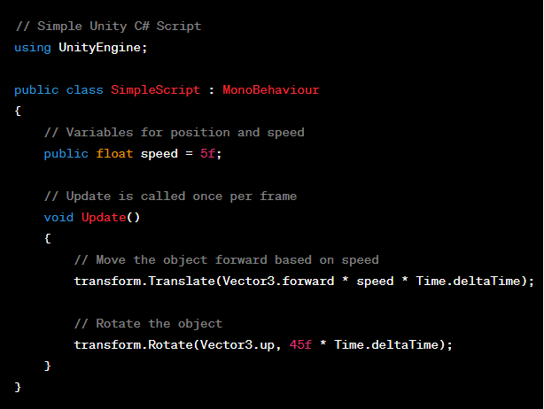
Basics of Unity Scripting in C#
The script is a basic example that moves and rotates a game object.
It utilizes the Update method, which is called every frame in Unity.
The object is moved forward and rotated based on the specified speed and time.
Simple Unity C# Script
Image source: Unity.com

Slide 27
Basics of Unity Scripting in C#
Script Execution Lifecycle:
Unity follows a specific lifecycle for executing scripts:
Awake(): Called when the script instance is being loaded.
Start(): Called on the frame when the script is enabled, useful for initialization.
Update(): Called once per frame for game logic updates.
FixedUpdate(): Called at a fixed interval for physics-related updates.
LateUpdate(): Called once per frame after all Update() functions.
Image source: Unity.com

Slide 28
Basics of Unity Scripting in C#
GameObjects and Components:
Scripts are attached to GameObjects as components, allowing them to interact with the game world.
GameObjects can have multiple scripts, each handling different aspects of behavior.
Components such as Transform, Rigidbody, and Collider can be accessed and modified via scripts.
Image source: Unity.com

Slide 29
Basics of Unity Scripting in C#
Variables and Data Types:
Scripts use variables to store and manipulate data.
Common data types include int, float, string, bool, and more.
Variables can be made public to be accessed and modified in the Unity Editor.
Unity Events and Messages:
Unity provides built-in events and messages that scripts can respond to:
OnMouseDown(): Called when the user clicks on a GameObject.
OnCollisionEnter(): Called when a collision occurs.
OnTriggerEnter(): Called when a GameObject enters a trigger collider.
Image source: Unity.com

Slide 30
Basics of Unity Scripting in C#
Asset Serialization:
Unity's serialization system allows script data to be saved with scenes and assets.
Serialized fields in scripts can be edited in the Unity Editor.
Enables the creation of prefab instances with predefined behavior.
Debugging and Logging:
Unity provides tools for debugging scripts, including the use of Debug.Log() for logging messages to the console.
Breakpoints and stepping through code are supported for more advanced debugging.
Image source: Unity.com

Slide 31
Basics of Unity Scripting in C#
C# Scripting Best Practices:
Use meaningful variable and method names for clarity.
Organize code into functions to improve readability.
Optimize performance by using the appropriate Unity API methods.
Regularly check the Unity Documentation for updates and new features.
Image source: Unity.com

Slide 32
The Console
The Console is where we will be reading the Developer outputs. These outputs can be used to quickly test bits of code without having to give added functionality for testing.
There are three types of messages that appear in the default console. These messages can be related to most of the compiler standards:
Errors
Warnings
Messages
Image source: Unity.com

Slide 33
The Console
Errors
Errors are issues or exceptions that will prevent the code from running at all.
Warnings
Warnings are issues that will not stop your code from running, but may pose issues during runtime.
Messages
Messages are outputs that convey something to the user; they do not usually highlight issues.
Image source: Unity.com

Slide 34
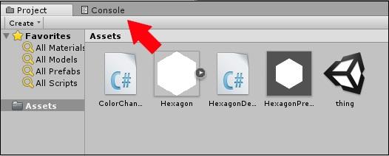
The Console
We can even have the Console output our own messages, warnings and errors. To do so, we will use the Debug class. The Debug class is a part of MonoBehaviour, which gives us methods to write messages to the Console, quite similar to how you would create normal output messages in your starter programs.
The Console can be found in the labelled tab above the Assets region.
Image source: Unity.com

Slide 35
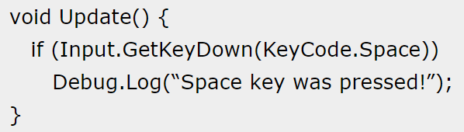
The Console
The outputs of the console are more useful to the programmer, not the end user or player.
Example: write a simple message to the Console which will notify us when the Space key was pressed. For this, we will use the Log method, which takes in an Object as a parameter, which we will use a string in.
Image source: Unity.com

Slide 36
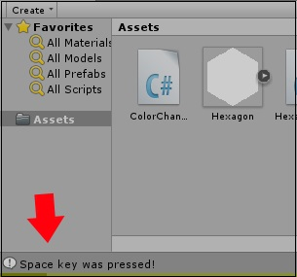
The Console
Saving, compiling and running this code (by attaching it to a GameObject, of course), try to hit the spacebar.
Similarly, you can also output warnings by using the LogWarning method and errors with the LogError method. These will prove to be useful for testing small bits of code without actually having to implement them
Image source: Unity.com

